Slide 1

Leveraging Machine Learning for Forest Fire Forecasting
- Rishita Chawla and Oliver Ward

Slide 2
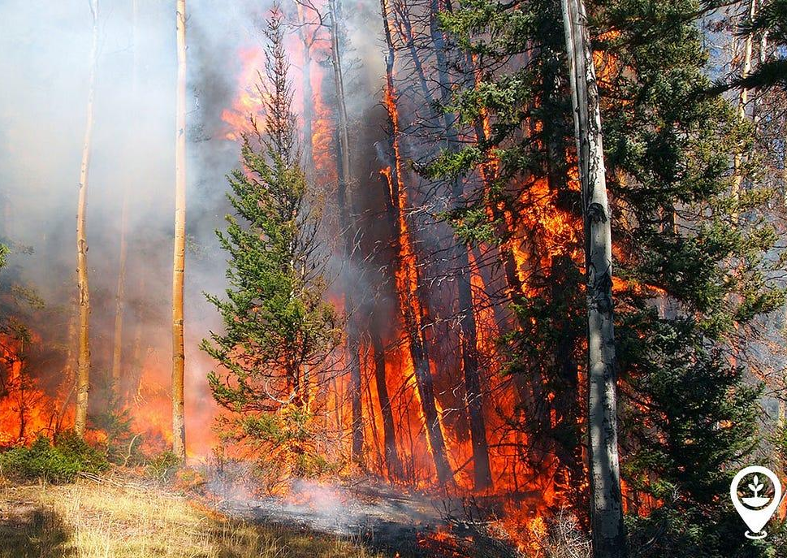
Introduction: The Growing Threat of Forest Fires
Growing Global Threat: More frequent & intense wildfires.
Devastating Impacts: Environment, economy, human safety.
Need for Early Prediction: Early warning & prevention are crucial.
ML for Fire Risk: Analyzing data to forecast potential.
Data-Driven Solution: A proactive approach to wildfire management.
Presentation Focus: ML model development for prediction.

Slide 3

Project Goals and Objectives
Understanding Dataset
Data Cleaning and Preprocessing
Data Visualization
ML-Model Training
Testing – Confusion Matrix and Accuracy Scores

Slide 4
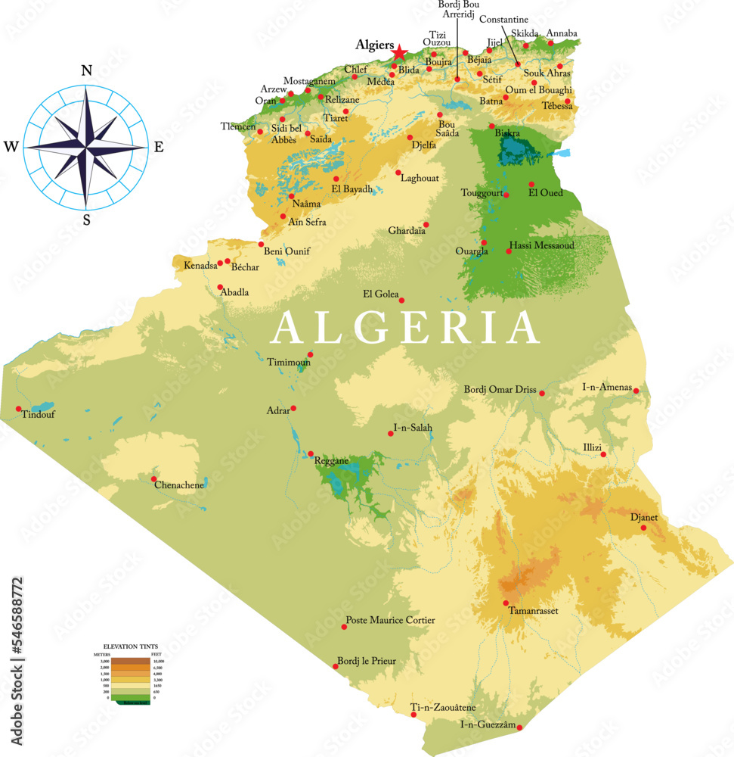
Understanding the Dataset
1
2
Algerian Forest Fire Data: Observations from Bejaia[1] and Sidi Bel-Abbes[2] regions.
Timeframe: June 2012 to September 2012.
Target Variable: 'Classes' (fire / not fire).
Weather Features: Temperature, Relative Humidity, Wind Speed, Rainfall.
FWI System Indices: FFMC, DMC, DC, ISI, BUI, FWI.

Slide 5

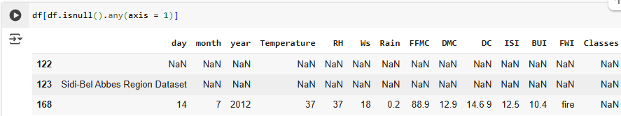
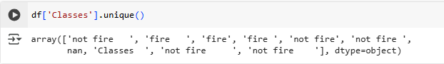
Problems in Dataset
Column names have Unwanted Spaces
Missing Values
The 'Classes' column contains multiple distinct categories

Slide 6
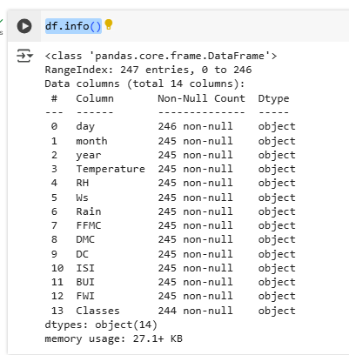
Problems in Dataset
Columns stored as object data types
Hence Data Cleaning and Preprocessing is needed!

Slide 7
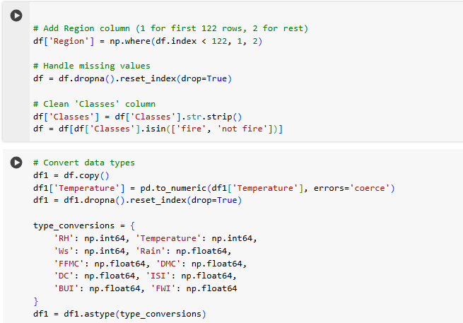
Data Cleaning and Preprocessing
Standardized column headers
Added “Region” column
Removed rows with missing data
Simplified “Classes” column to two categories
Updated datatypes for consistency
Normalized numeric features with StandardScaler
Split data 75/25 for training and testing

Slide 8
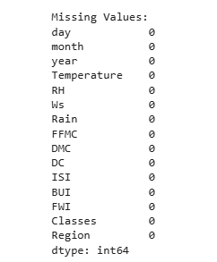
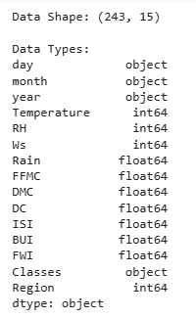
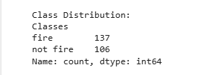
Results of Data Cleaning

Slide 9
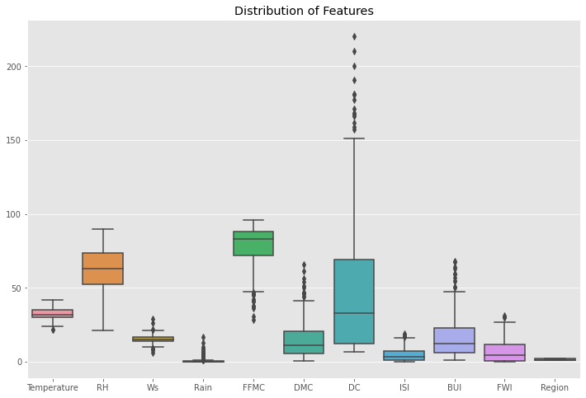
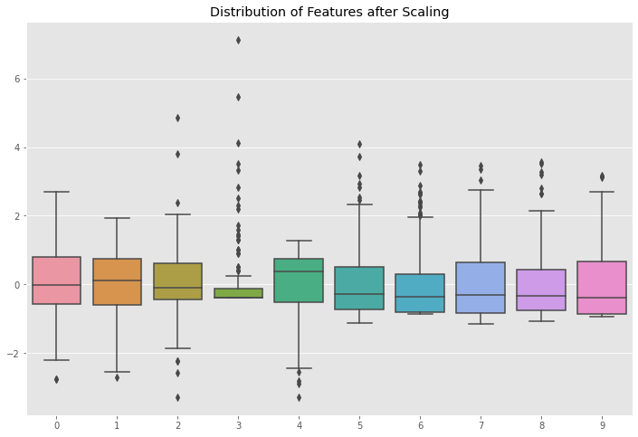
Data Visualization
Data before Scaling
Data after Scaling

Slide 10
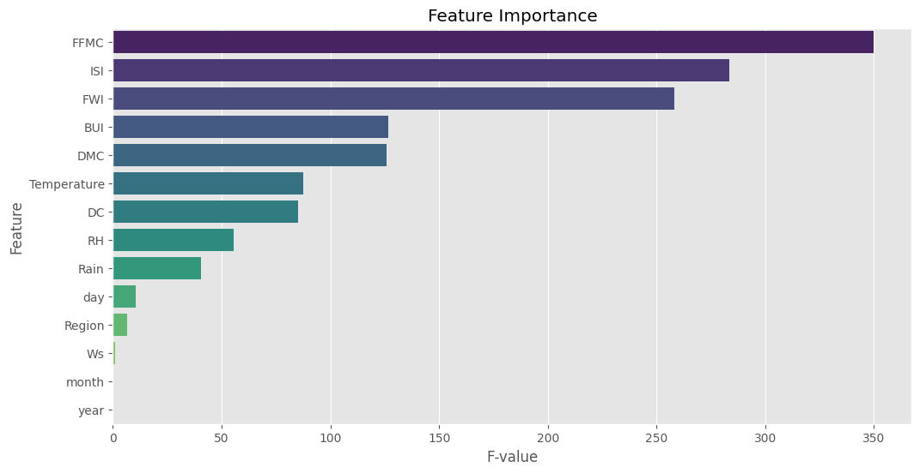
Feature-Selection
Notes:
ffmc - how dry organic matter is in environment
ISI - the spread index
FWI - fire weather index
BUI - the build up of leaves and whatnot

Slide 11
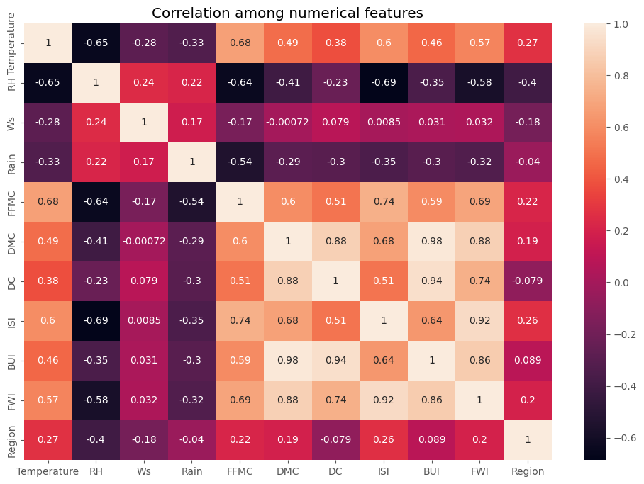
Correlation Heatmap

Slide 12
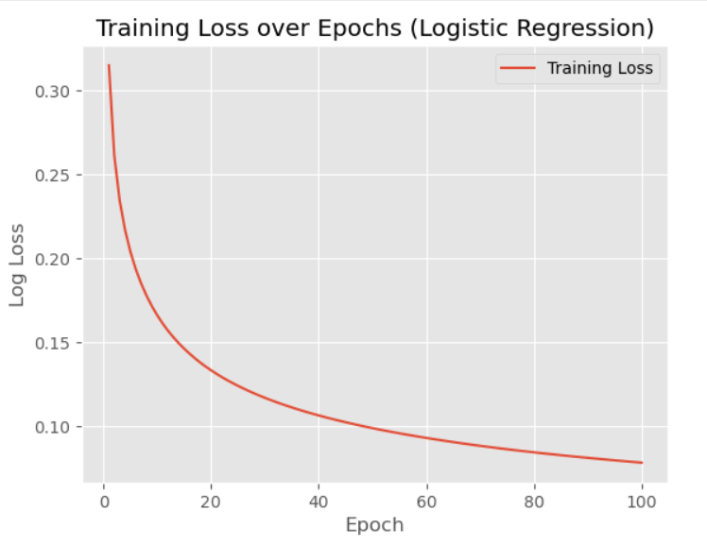
Model Training
K-Nearest Neighbors (KNN) Classifies based on the majority label of the K closest points.
Gaussian Naive Bayes Uses Bayes' Theorem with normal distribution assumptions.
Logistic Regression Predicts class probability using a sigmoid function.

Slide 13
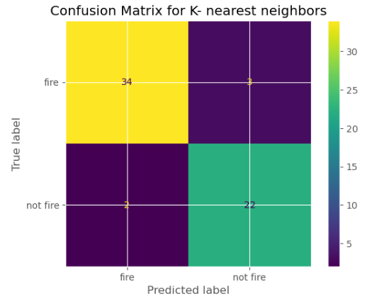
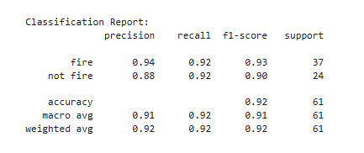
K - nearest neighbors results

Slide 14
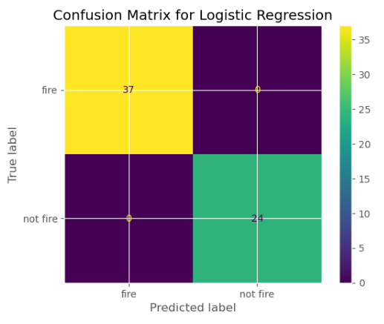
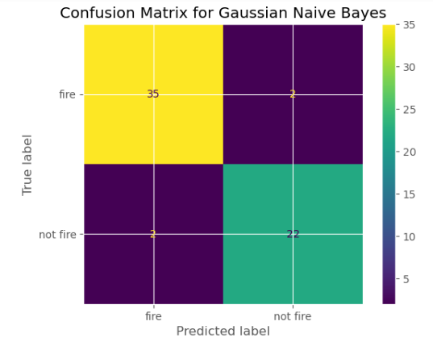
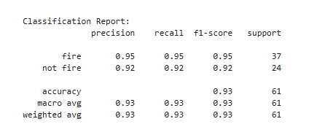
Gaussian Naive Bayes

Slide 15
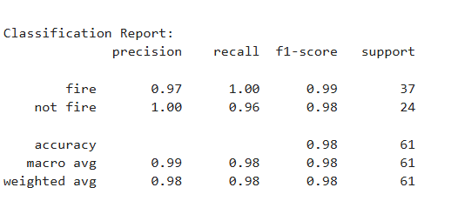
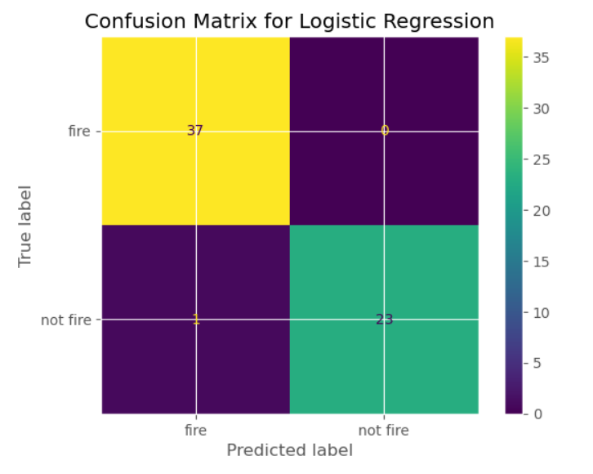
Logistic Regression
Notes:
unsure of overfitting due to a possible similarity

Slide 16
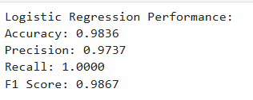
Logistic Regression
Our Logistic Regression Model performed excellently, achieving high scores across all metrics. Given the strong performance, we tested for overfitting, which was a concern. As shown below, our model was not overfit and was able to reliably predict generalized information.

Slide 17
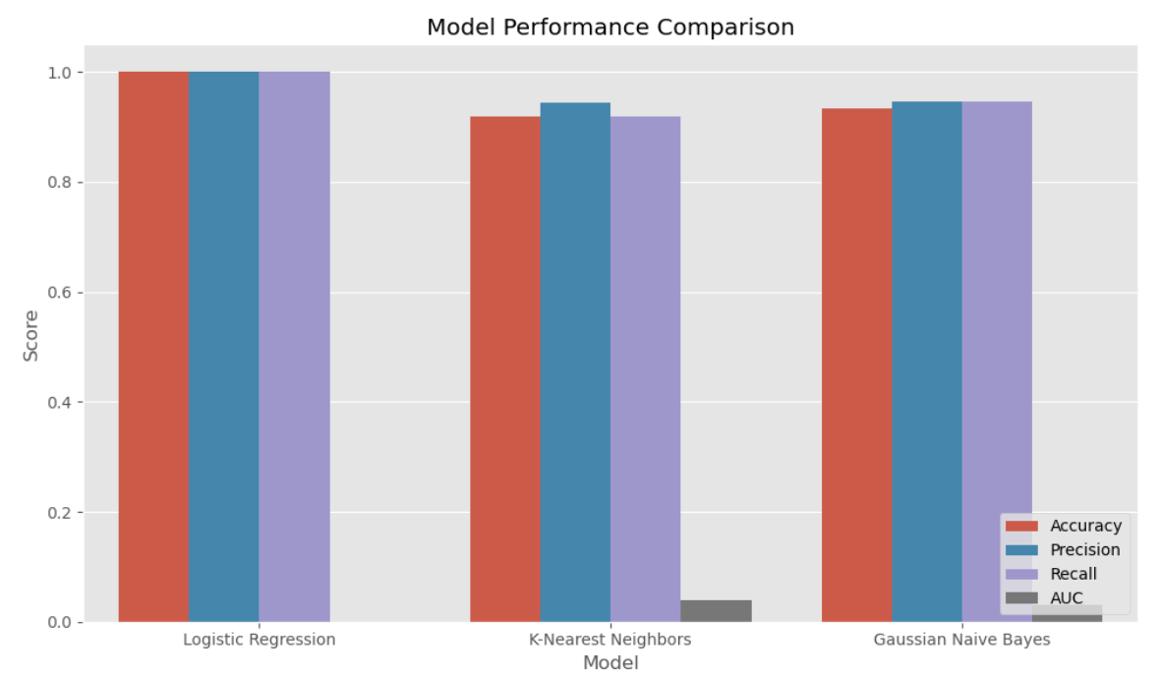
Performance Comparison

Slide 18
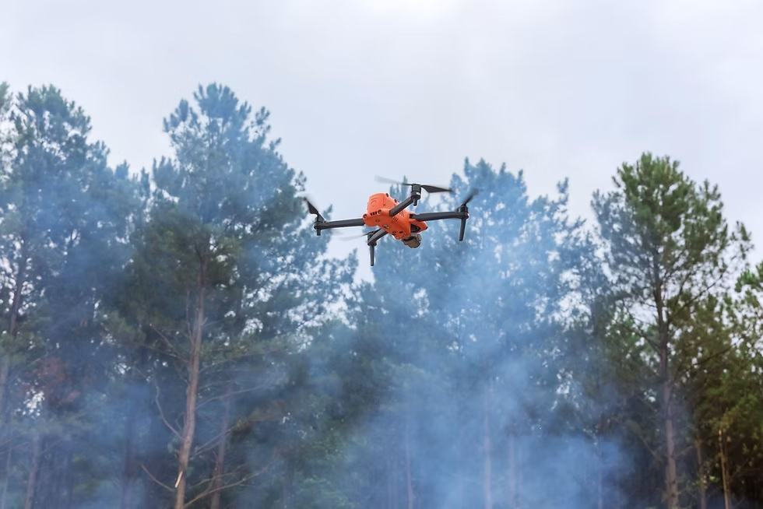
Future Improvements
Model Refinement Explore advanced models like Random Forests, XGBoost, and Neural Networks.
Feature Engineering Incorporate additional features like soil moisture, vegetation types, and drought indices.
Real-time Data Integration Integrate live satellite imagery and weather data for dynamic predictions.
Data Augmentation Increase training data diversity with synthetic data or more localized datasets.
Notes:
https://www.sciencedirect.com/science/article/pii/S0048969721029430

Slide 19
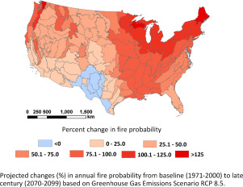
Future Implications
Real-time Alerts for faster wildfire response.
Optimized Resource Allocation based on risk predictions.
Climate Change Analysis to track fire patterns.
Enhanced Data Integration with satellite and sensor data.
Support for Policy in forest management and prevention.
Notes:
https://www.sciencedirect.com/science/article/pii/S0048969721029430

Slide 20



Conclusion
Logistic Regression is the Best Model in our scope
Highest Accuracy among all tested models
Best Prediction Performance on test data
Simple, Fast, and Interpretable for real-world use
The Future
Stronger models built off stronger data
Easier to understand visuals
Live updates

Slide 21
Research-References
[1]“Cleaning Data Types — Practical Data Science with Python,” Practicaldatascience.org, 2024. https://www.practicaldatascience.org/notebooks/class_3/week_3/33_cleaning_datatypes.html (accessed Apr. 24, 2025).
[2]“How to create a seaborn correlation heatmap in Python?,” GeeksforGeeks, Nov. 09, 2020. https://www.geeksforgeeks.org/how-to-create-a-seaborn-correlation-heatmap-in-python/
[3]Sampath Kumar Gajawada, “ANOVA for Feature Selection in Machine Learning - TDS Archive - Medium,” Medium, Oct. 19, 2019. https://medium.com/data-science/anova-for-feature-selection-in-machine-learning-d9305e228476 (accessed Apr. 24, 2025).
[4] “Impact of Forest Fires on the Environment: A Review of the Effects of Fire on Soil, Vegetation, and Water Resources,” ScienceDirect, 2021. https://www.sciencedirect.com/science/article/pii/S0048969721029430 (accessed Apr. 24, 2025).

Slide 22
Thank You !

